Slide 1

Analyzing the Reception of PC Video Games through Steam Data
By Afnan Dzaharudin

Slide 2
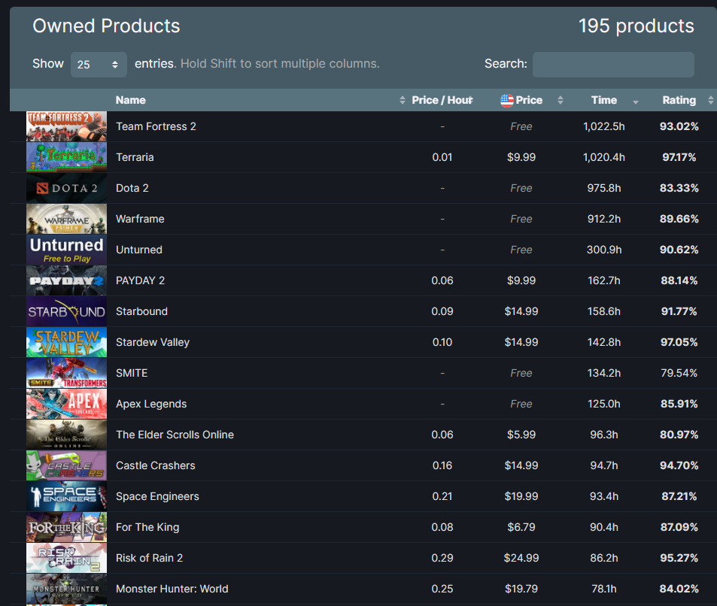


Introduction
I like video games
I like video games a lot

Slide 3
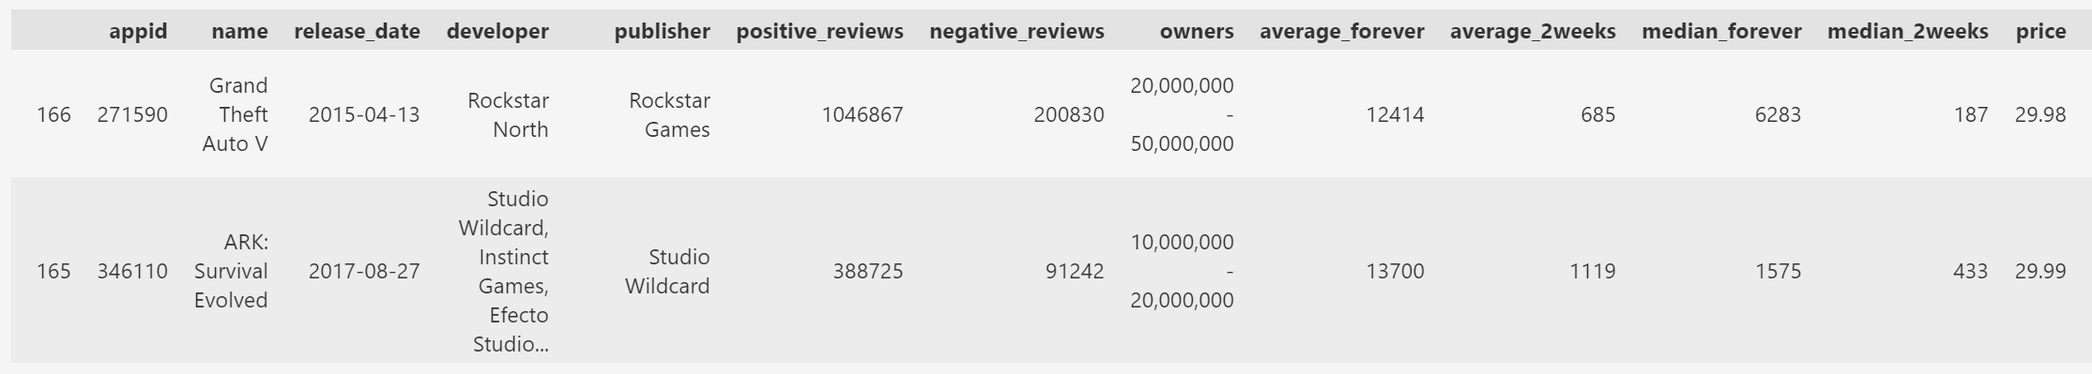
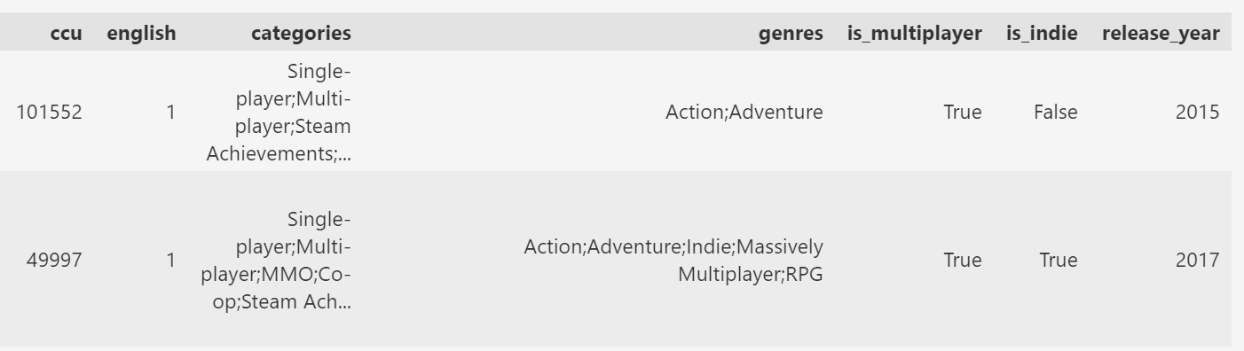
Dataset

Slide 4
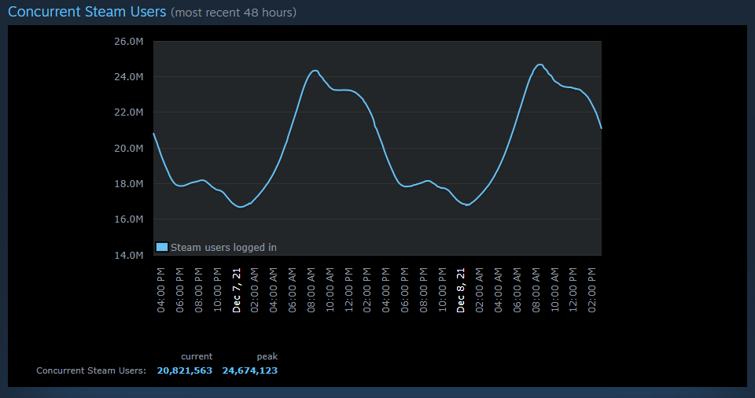
Descriptive Analytics
CCU (Concurrent Users)

Slide 5
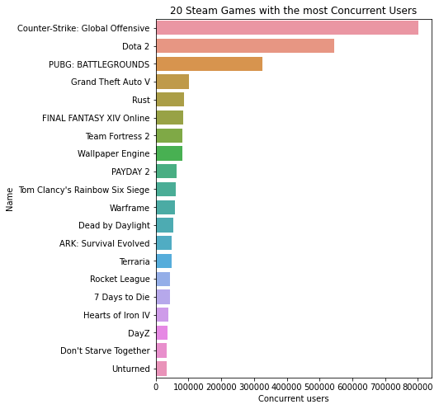
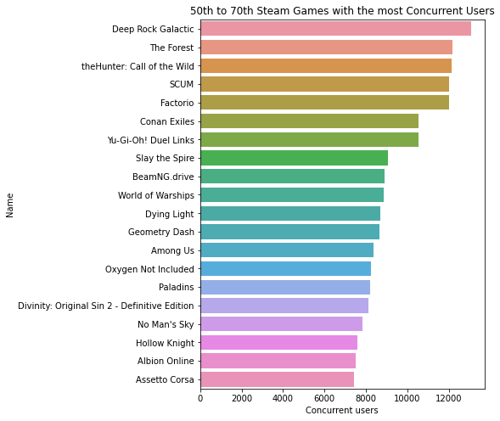
Descriptive Analytics

Slide 6
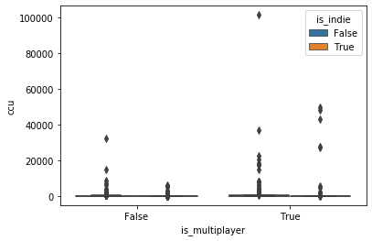
Descriptive Analytics
Concurrent Users ~ is_multiplayer + is_indie

Slide 7
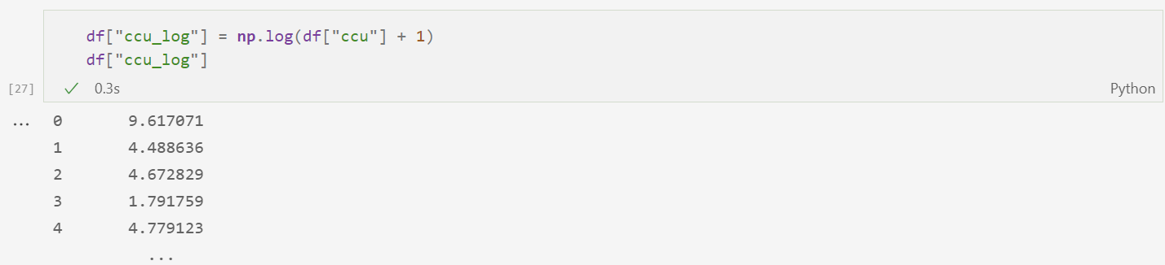
Descriptive Analytics

Slide 8
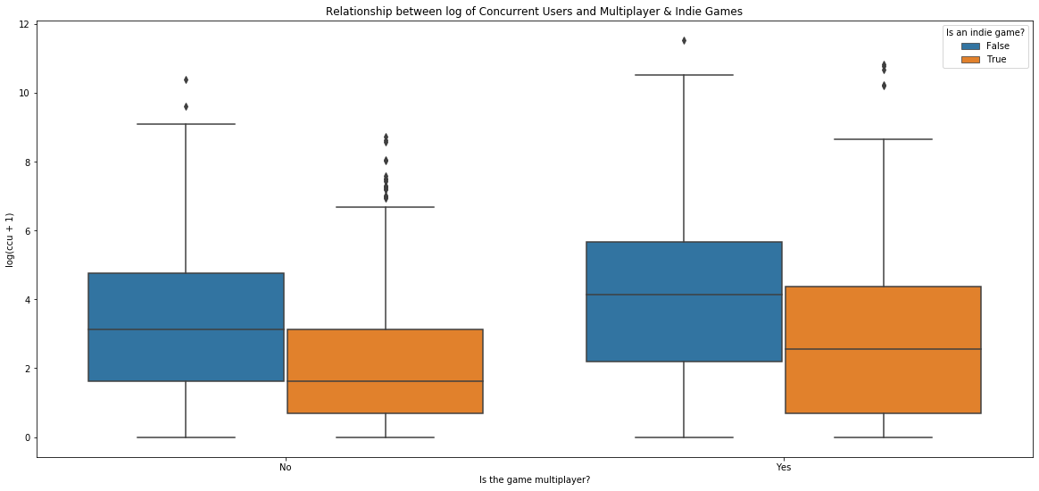
Descriptive Analytics

Slide 9
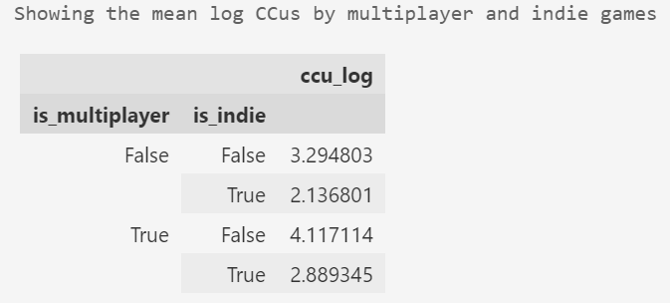
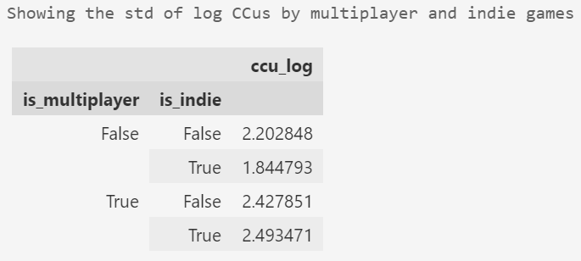
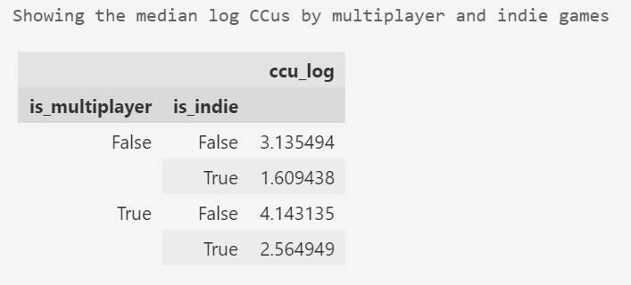
Descriptive Analytics

Slide 10



Inference
Free-to-play vs. Paid Games

Slide 11




Inference

Slide 12
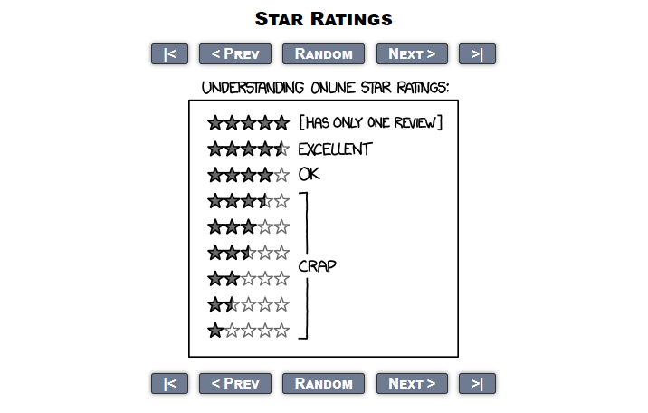
Inference

Slide 13
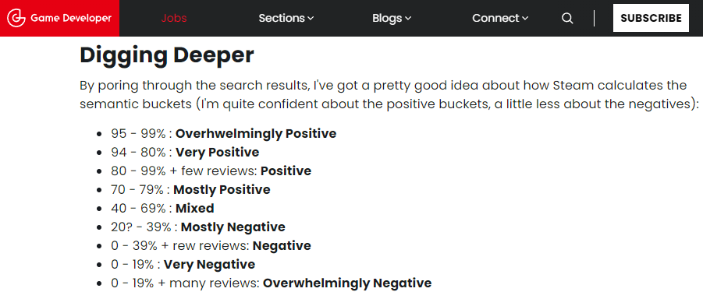
Inference

Slide 14
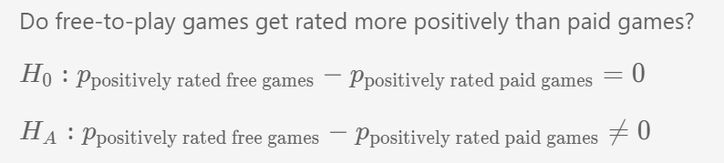
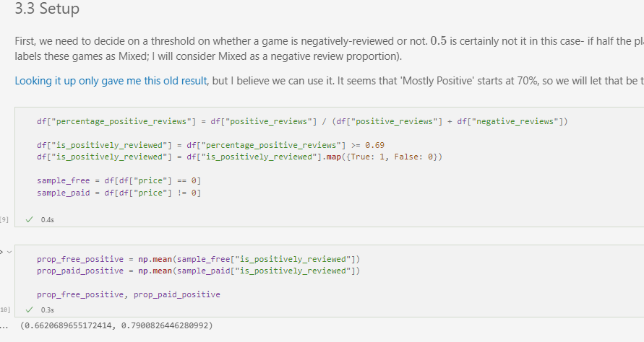
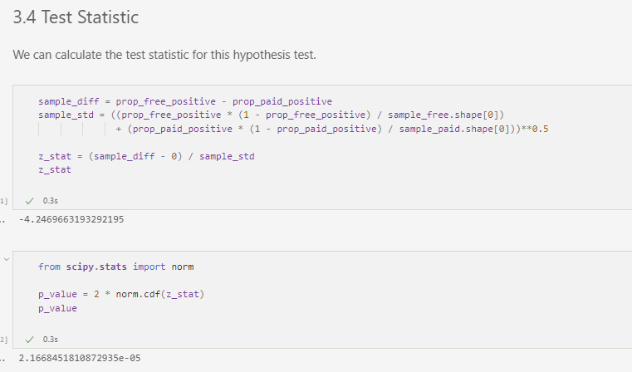
Inference

Slide 15
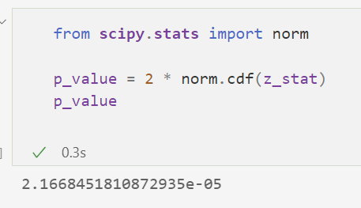

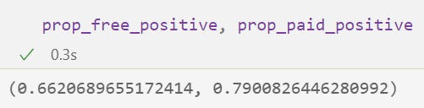
Inference

Slide 16
Linear Regression
Is there a relationship between a game’s concurrent users (CCU)
and:
Owner count
Release date (measured by year)
Positive & negative reviews
Median playtime (in 2 weeks & all-time)
Multiplayer games & indie games

Slide 17
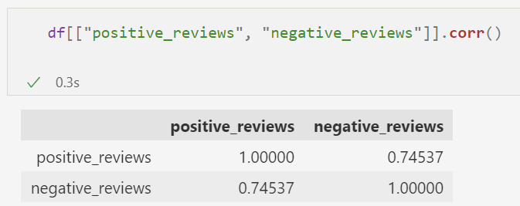
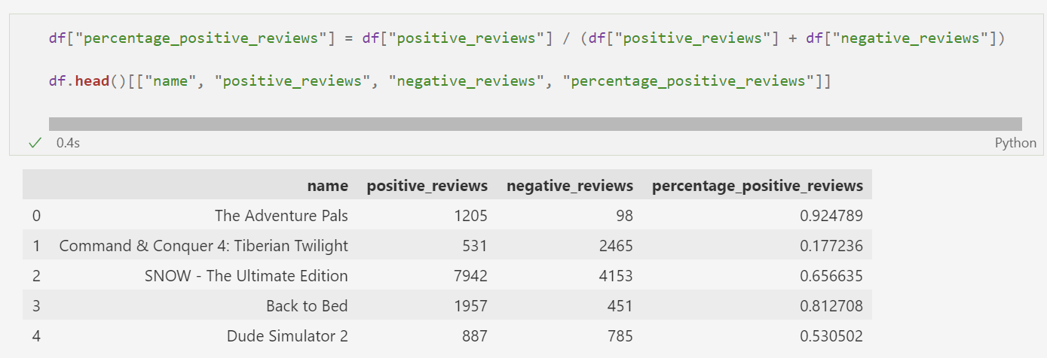
Linear Regression

Slide 18
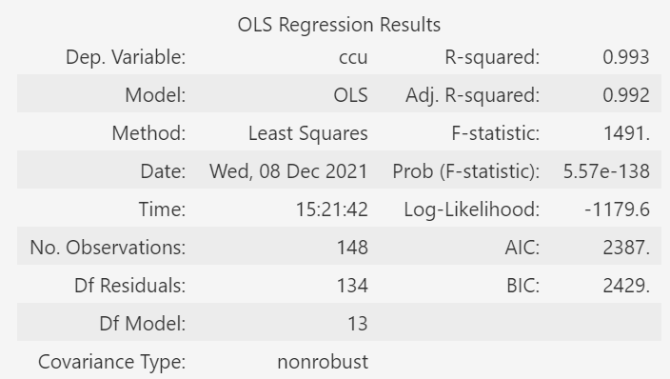
Linear Regression
Use all variables without transformation

Slide 19
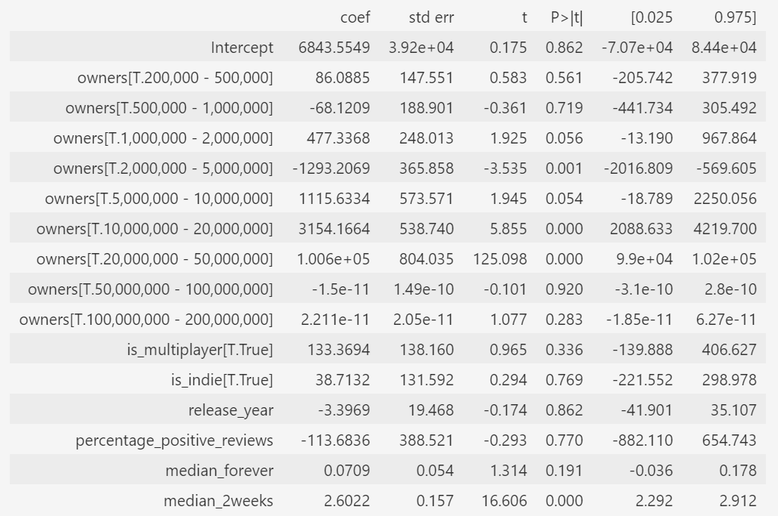
Linear Regression
Use all variables without transformation

Slide 20
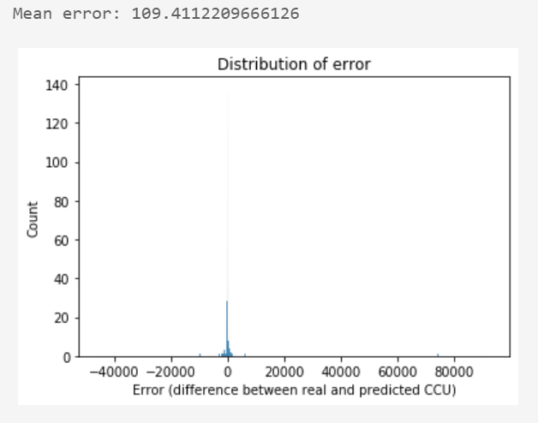
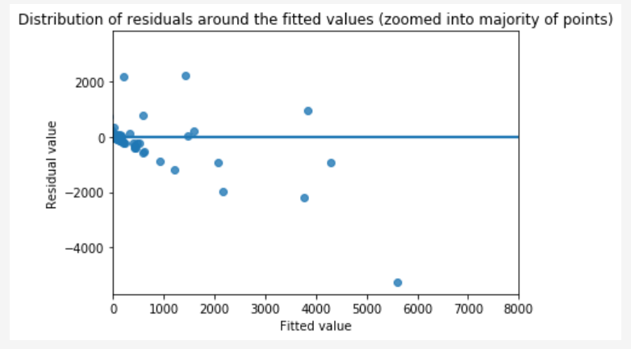
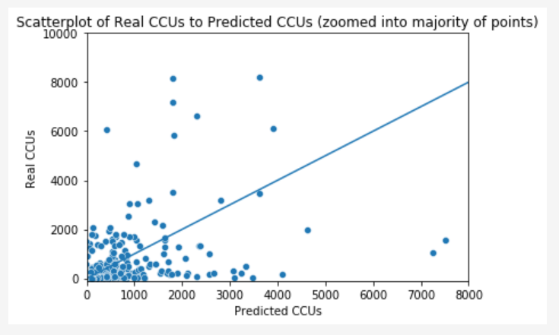
Linear Regression
Visualize the residuals & fitted values

Slide 21
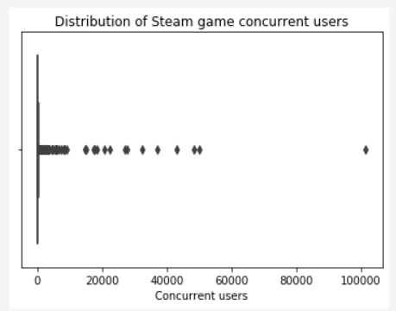
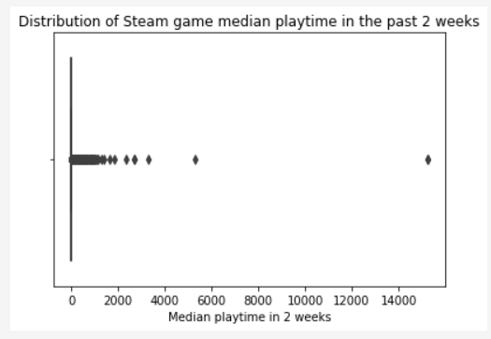
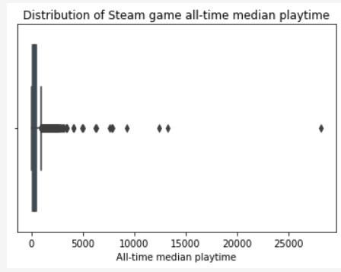
Linear Regression
Visualize the responsible numerical variables

Slide 22
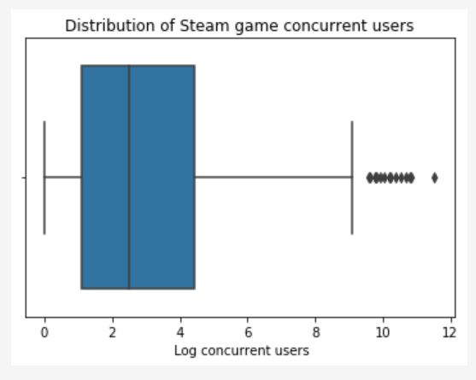
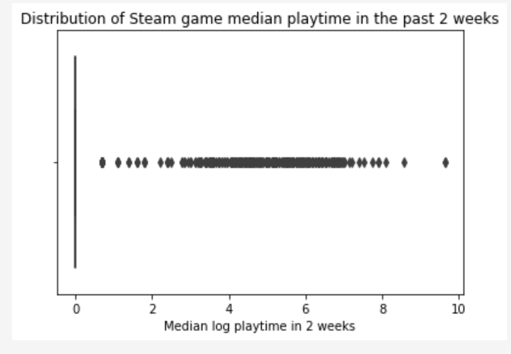
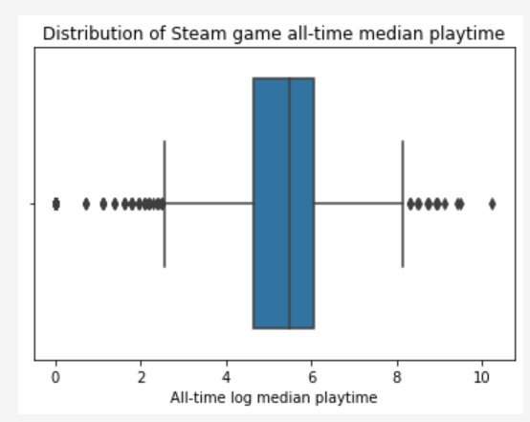
Linear Regression
Post-transformation visualization

Slide 23

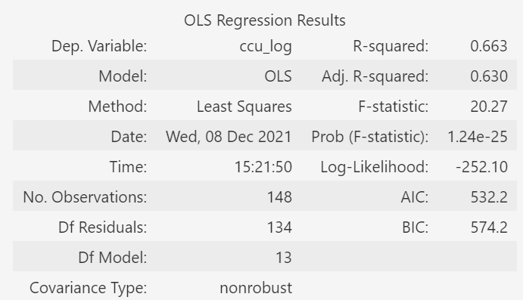
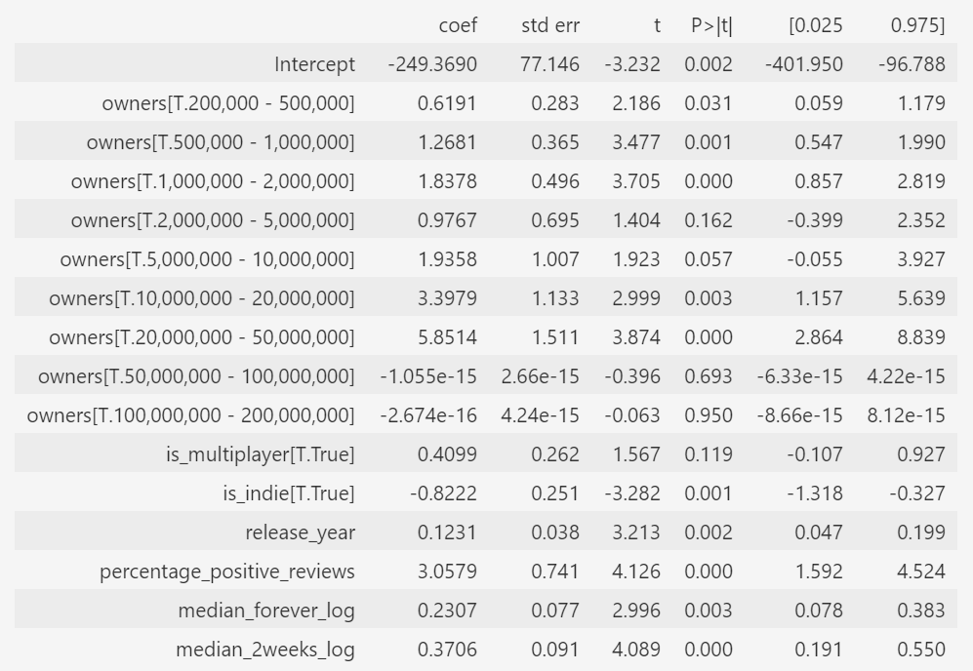
Linear Regression

Slide 24
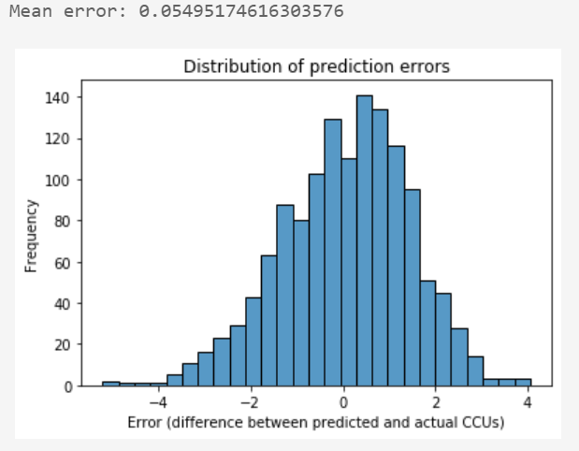
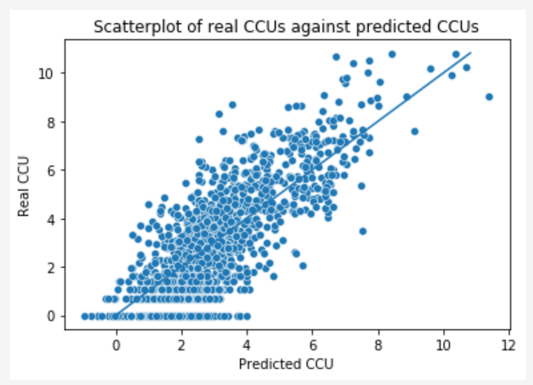
Linear Regression
Performance (General)

Slide 25
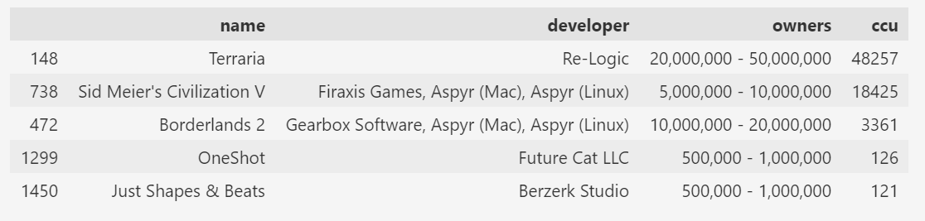
Linear Regression
Performance (Specific Games)

Slide 26
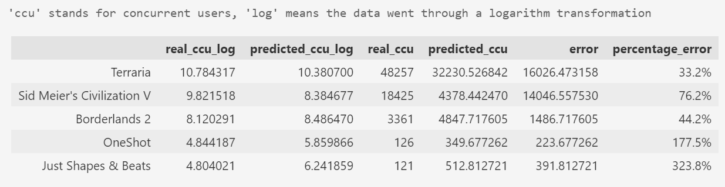
Linear Regression
Performance (Specific Games)

Slide 27
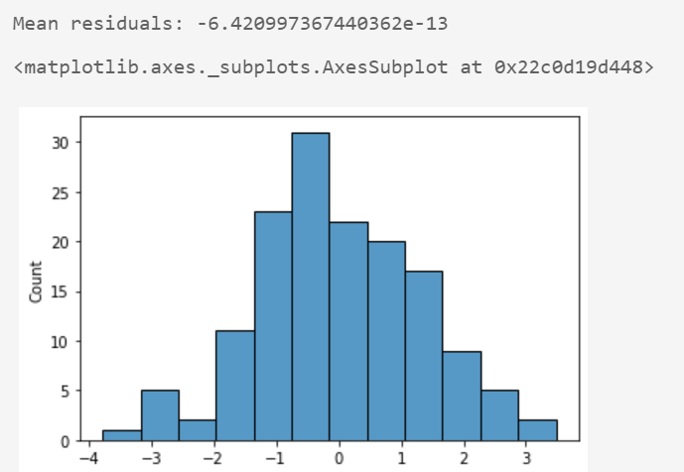
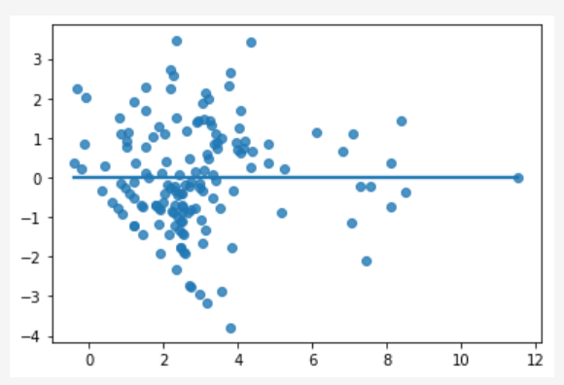
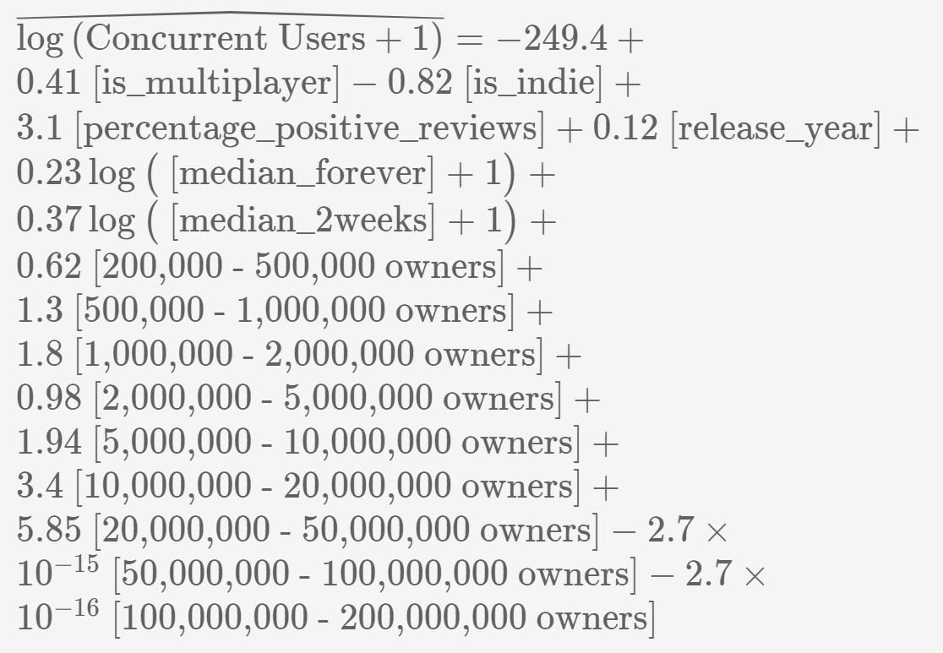
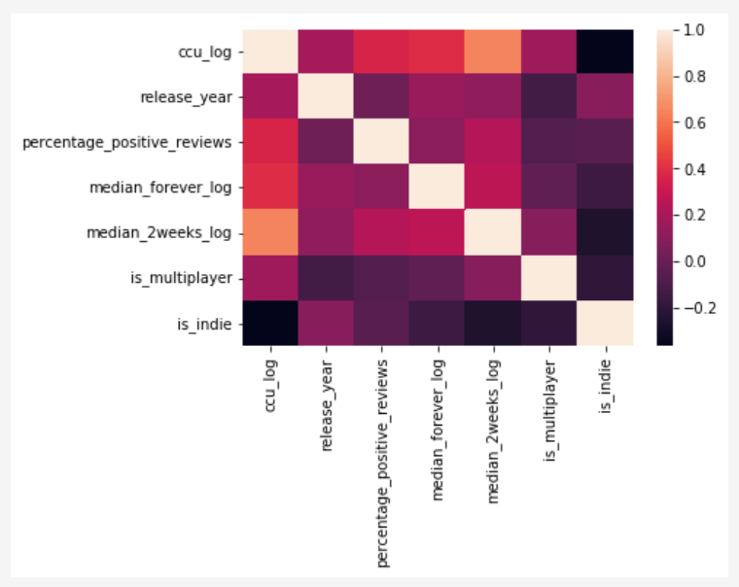
Linear Regression
Conclusion

Slide 28
Logistic Regression
Is there a relationship between the log-odds that a game is positive-reviewed and:
Price
Median playtime (in 2 weeks & all-time)
Multiplayer games & indie games

Slide 29
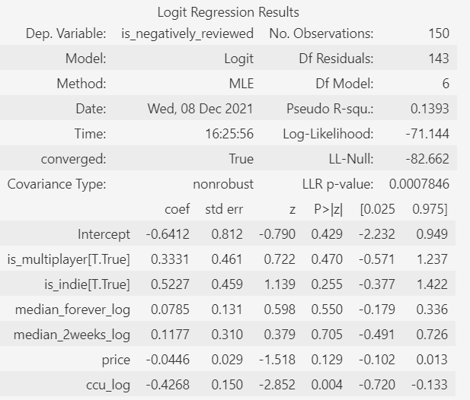
Logistic Regression

Slide 30
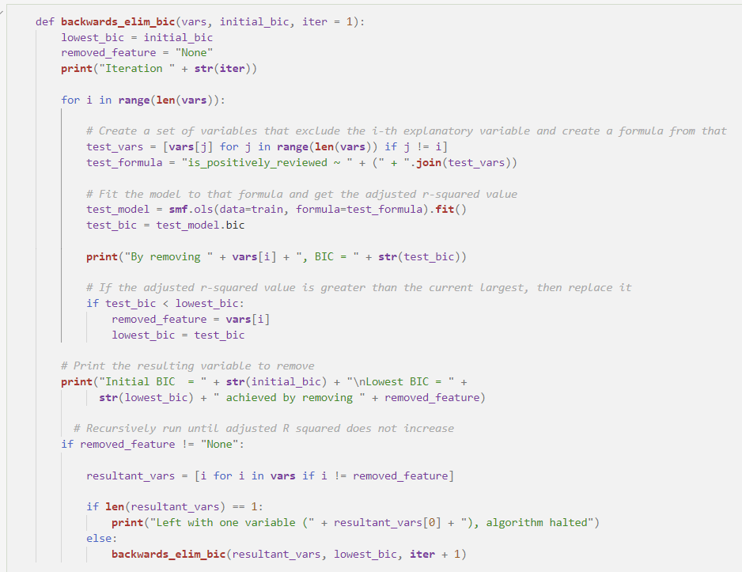
Logistic Regression
Parsimoniousness – Backwards Elimination

Slide 31
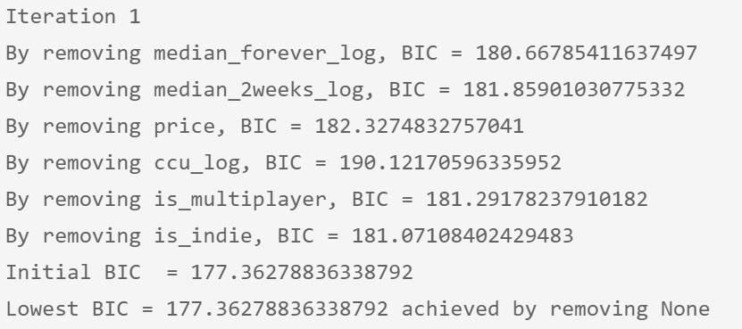
Logistic Regression
Parsimoniousness – Backwards Elimination

Slide 32
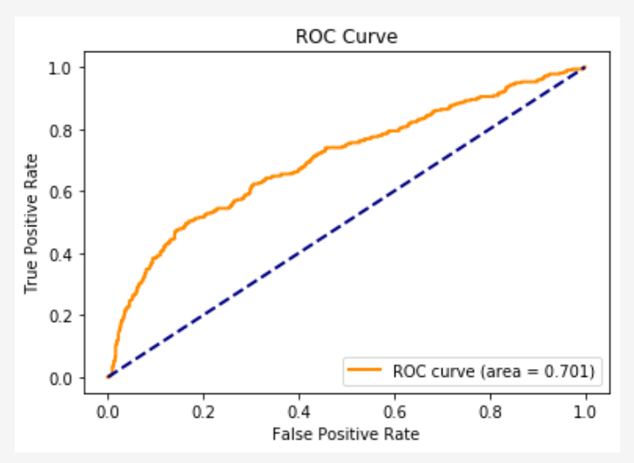
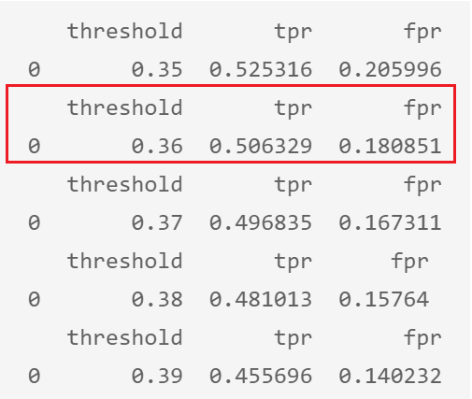
Logistic Regression
ROC Curve & AUC, finding the threshold

Slide 33
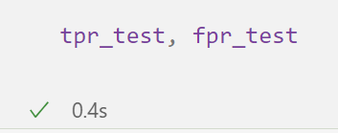

Logistic Regression
Apply threshold to test set

Slide 34
Logistic Regression
Conclusion

Slide 35
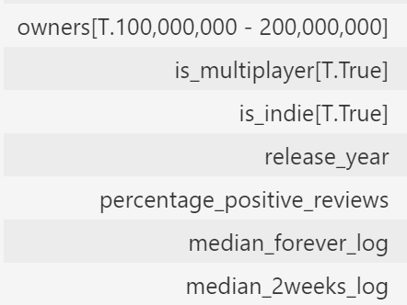

Conclusion
Descriptive Analytics
Inference
Rejected null; free games are more positively-reviewed than paid games
Linear Regression
Logistic Regression

